Slide 1
How Many Right-Angled Triangles?

Slide 2
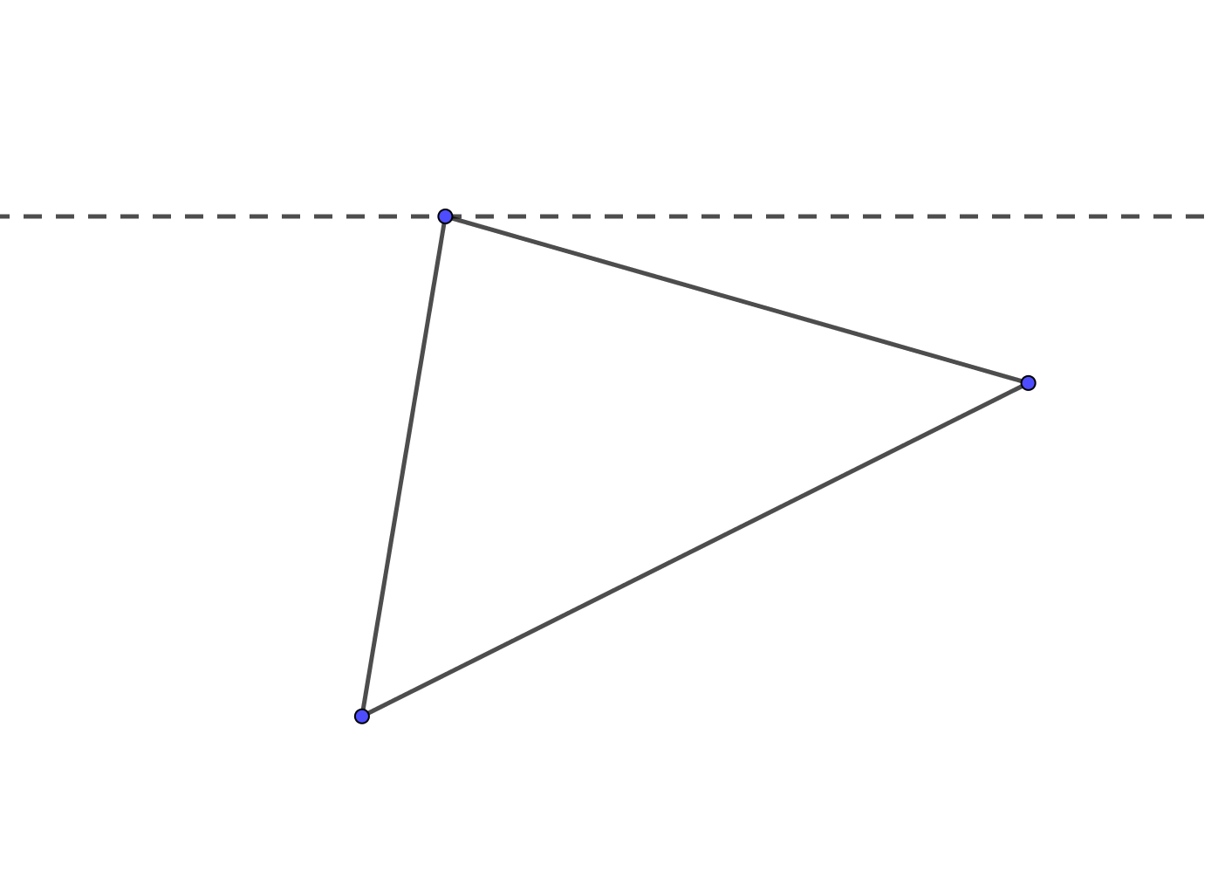



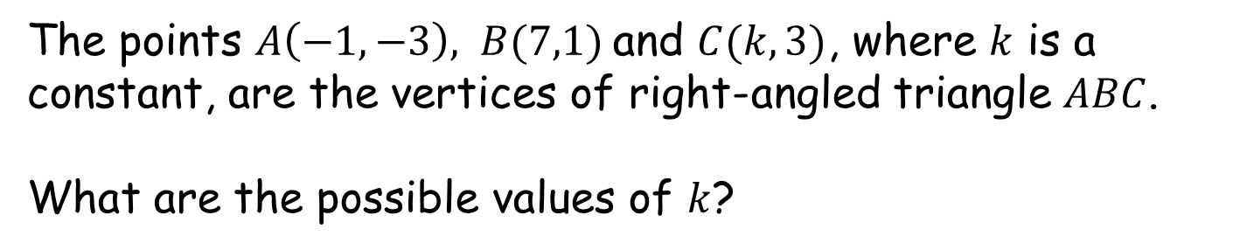
How Many Right-Angled Triangles?
$$C$$
$$B$$
(Not to scale)
$$A$$
The points $A\left(−1,−3\right), B(7,1)$and $C(k,3)$, where $k$ is a constant, are the vertices of right-angled triangle $ABC$.
What are the possible values of $k$?
Notes:
This is worksheet I.

Slide 3
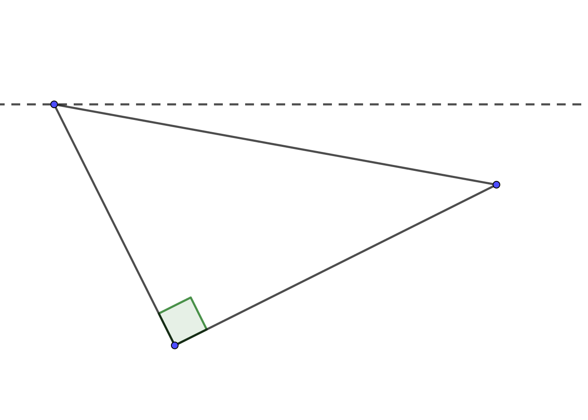


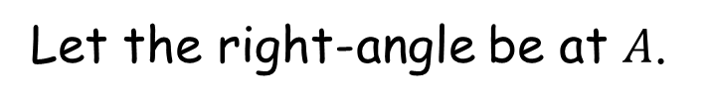


How Many Right-Angled Triangles?
Let the right-angle be at $A$.
$$C (k,3)$$
$$B$$
$$(7,1)$$
${AC}^{2}+{AB}^{2}={BC}^{2}$
${\left(k+1\right)}^{2}+6^{2}+8^{2}+4^{2}={\left(k−7\right)}^{2}+2^{2}$
$k^{2}+2k+117=k^{2}−14k+53$
$16k=−64$
$k=−4$
$$A$$
$$\left(−1,−3\right)$$
Notes:
K=-4

Slide 4
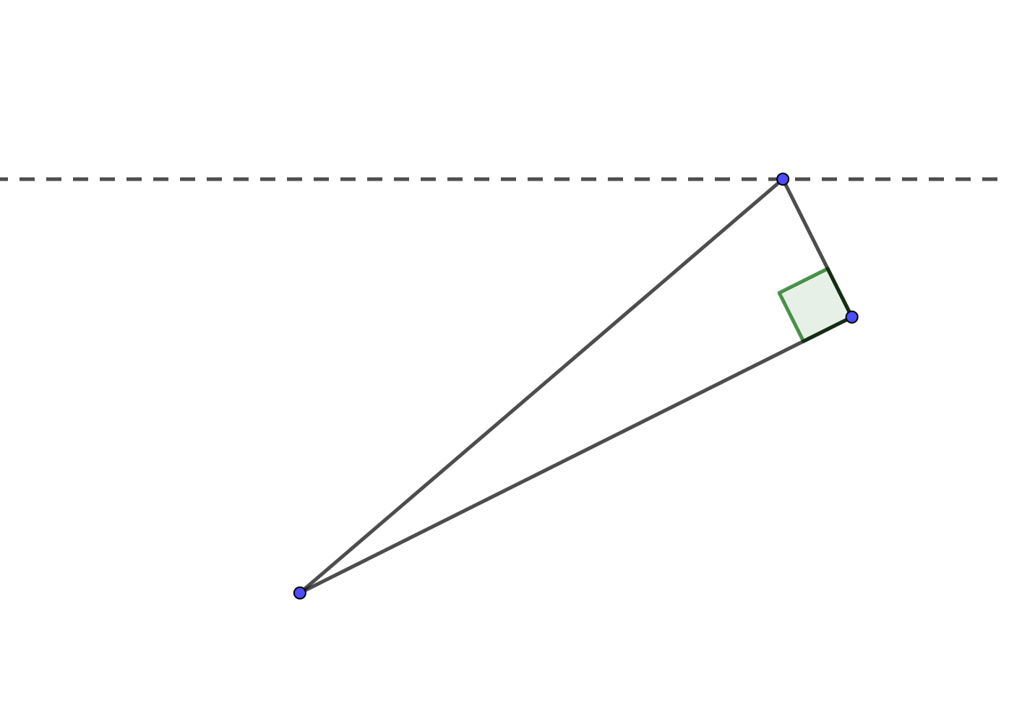
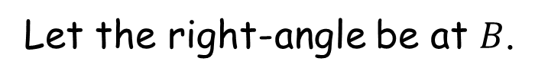


How Many Right-Angled Triangles?
Let the right-angle be at $B$.
$$C (k,3)$$
$$B$$
$$(7,1)$$
${AB}^{2}+{BC}^{2}={AC}^{2}$
$8^{2}+4^{2}+{\left(k−7\right)}^{2}+2^{2}={\left(k+1\right)}^{2}+6^{2}$
$k^{2}−14k+133=k^{2}+2k+37$
$96=16k$
$k=6$
$$A$$
$$\left(−1,−3\right)$$
Notes:
K=6

Slide 5
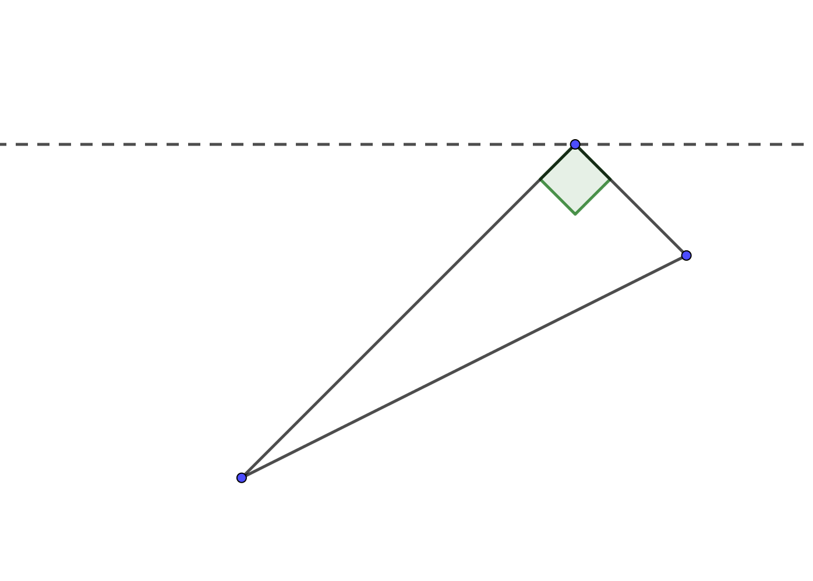
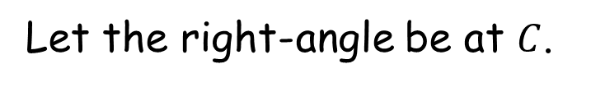
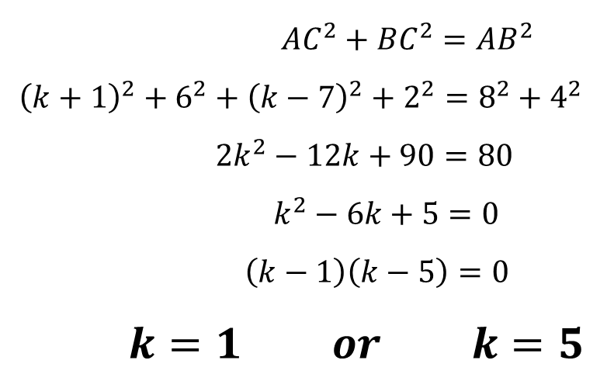

How Many Right-Angled Triangles?
Let the right-angle be at $C$.
$$C (k,3)$$
$$B$$
$$(7,1)$$
${AC}^{2}+{BC}^{2}={AB}^{2}$
${\left(k+1\right)}^{2}+6^{2}+{\left(k−7\right)}^{2}+2^{2}=8^{2}+4^{2}$
$2k^{2}−12k+90=80$
$k^{2}−6k+5=0$
$\left(k−1\right)\left(k−5\right)=0$
$k=1 or k=5$
$$A$$
$$\left(−1,−3\right)$$
Notes:
K=5

Slide 6
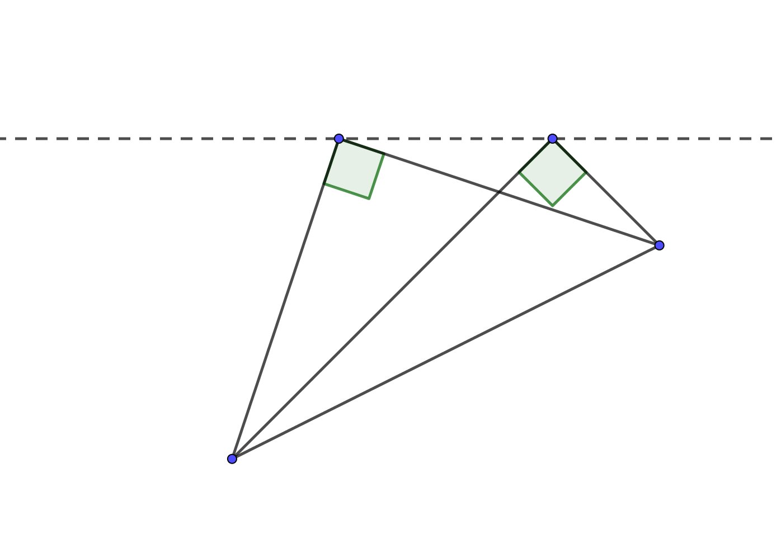
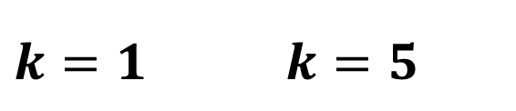
How Many Right-Angled Triangles?
$k=1$ $k=5$
$$B$$
$$A$$

Slide 7
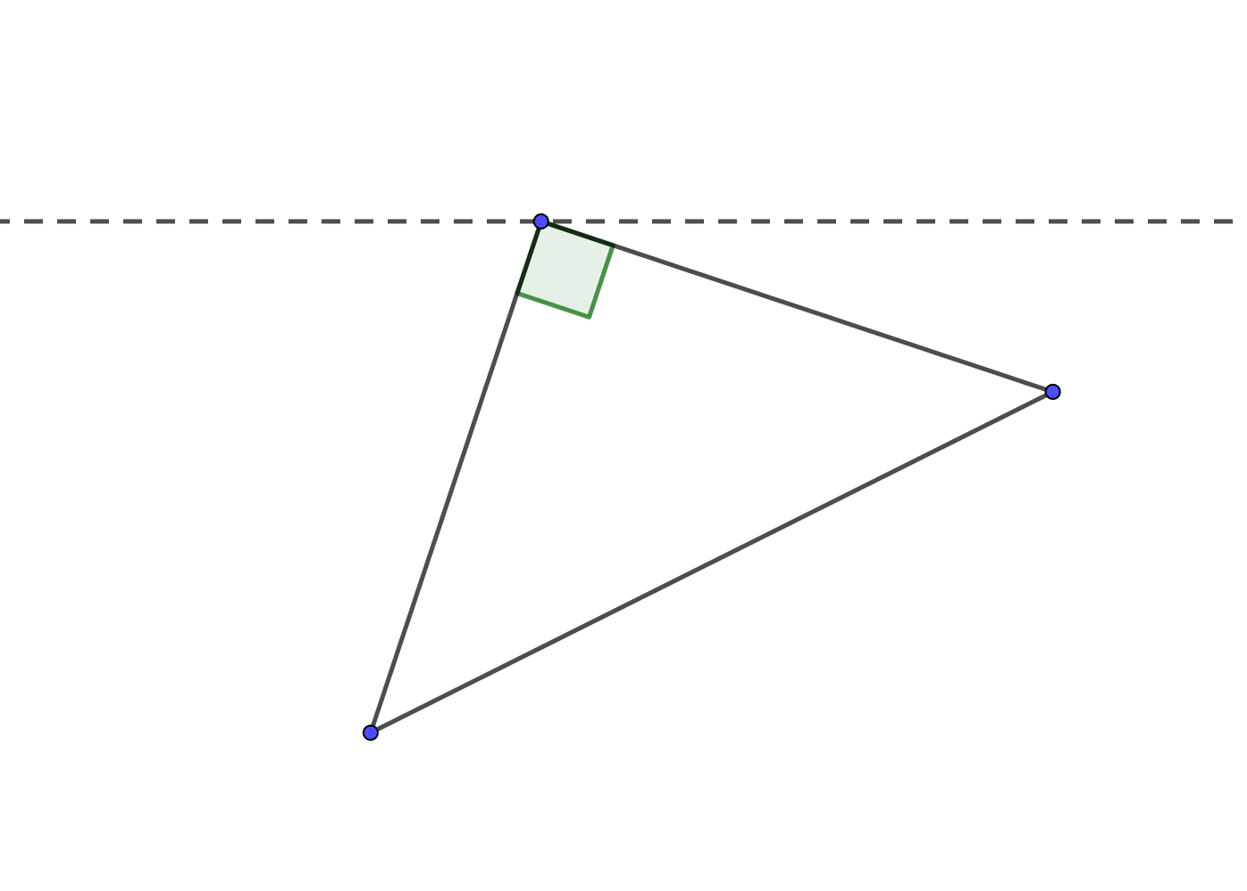
















How Many Right-Angled Triangles?
$$C$$
$$k=−4$$
$$k=6$$
$$C$$
$$B$$
$$B$$
$$A$$
$$A$$
Why does the right-angle at C have two solutions?
$$k=1$$
$$C$$
$$k=5$$
$$C$$
$$B$$
$$B$$
$$A$$
$$A$$
Notes:
K=1

Slide 8
How Many Right-Angled Triangles?
$k=1$ $k=5$
$$B$$
$$A$$
(HINT: Circle Theorems)

Slide 9
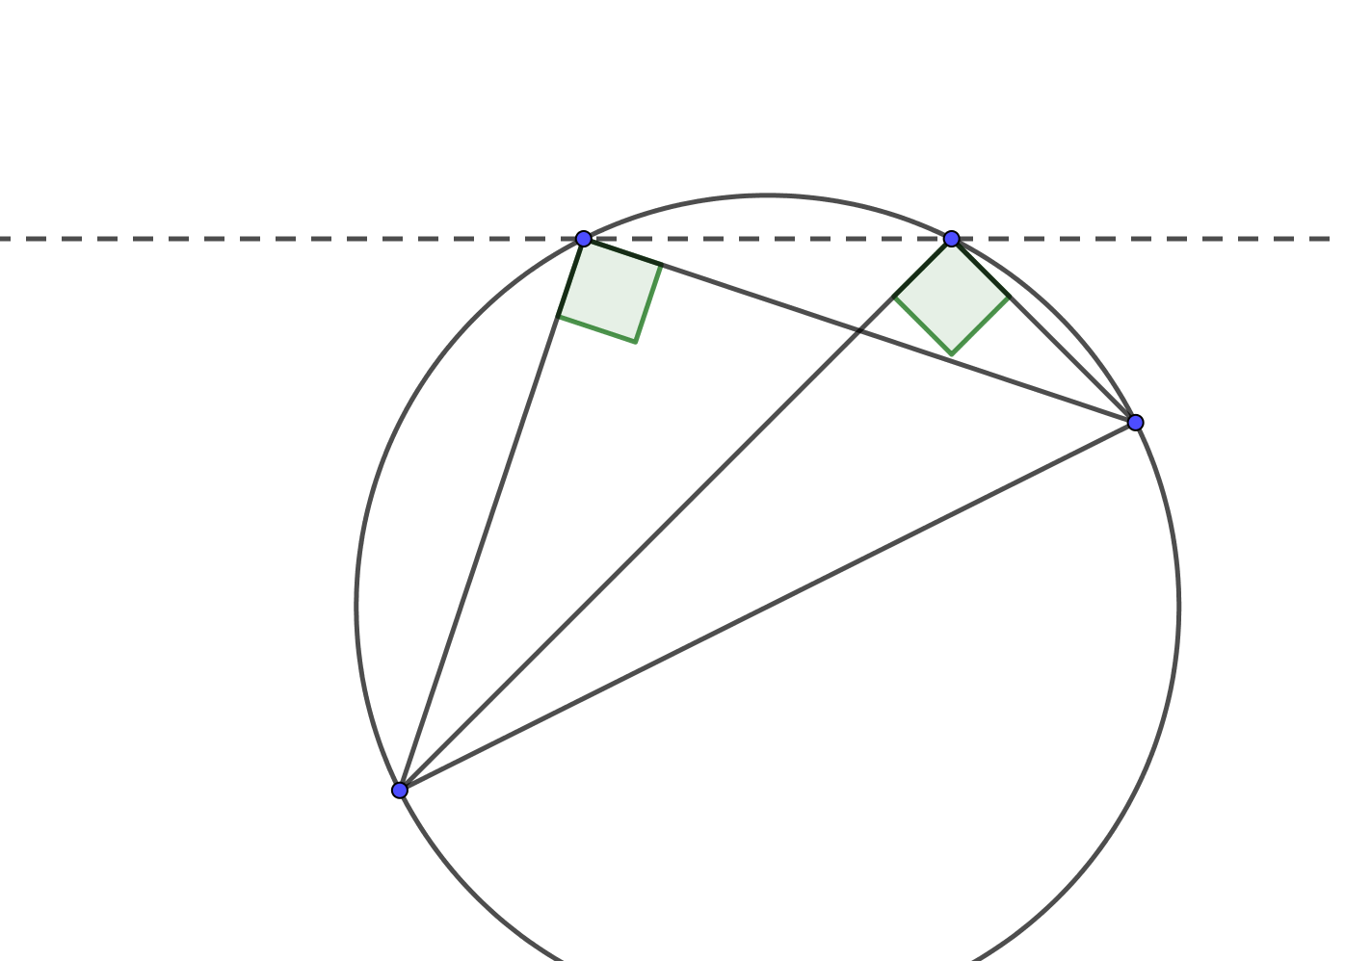
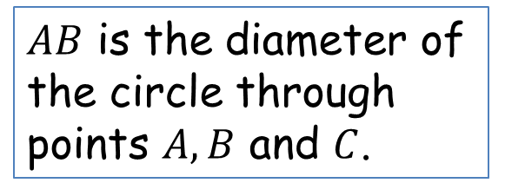
How Many Right-Angled Triangles?
$k=1$ $k=5$
$$B$$
$$A$$
$AB$ is the diameter of the circle through points $A, B$ and $C$.
“The angle in a semi-circle is a right-angle”

Slide 10
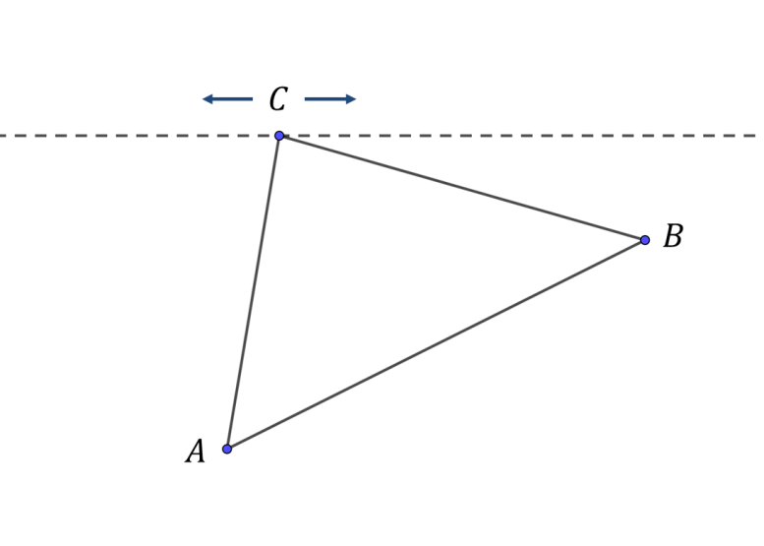
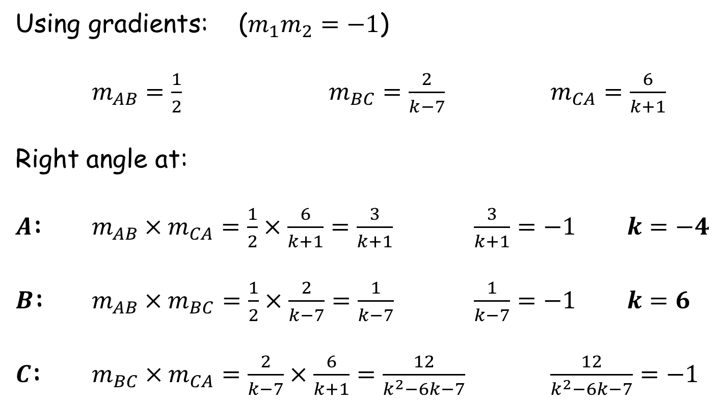
How Many Right-Angled Triangles?
Using gradients: ($m_{1}m_{2}=−1$)
$m_{AB}=\frac{1}{2}$ $m_{BC}=\frac{2}{k−7}$ $m_{CA}=\frac{6}{k+1}$
Right angle at:
$A$: $m_{AB}×m_{CA}=\frac{1}{2}×\frac{6}{k+1}=\frac{3}{k+1}$ $\frac{3}{k+1}=−1$ $k=−4$
$B$: $m_{AB}×m_{BC}=\frac{1}{2}×\frac{2}{k−7}=\frac{1}{k−7}$ $\frac{1}{k−7}=−1$ $k=6$
$C$: $m_{BC}×m_{CA}=\frac{2}{k−7}×\frac{6}{k+1}=\frac{12}{k^{2}−6k−7}$ $\frac{12}{k^{2}−6k−7}=−1$

Slide 11
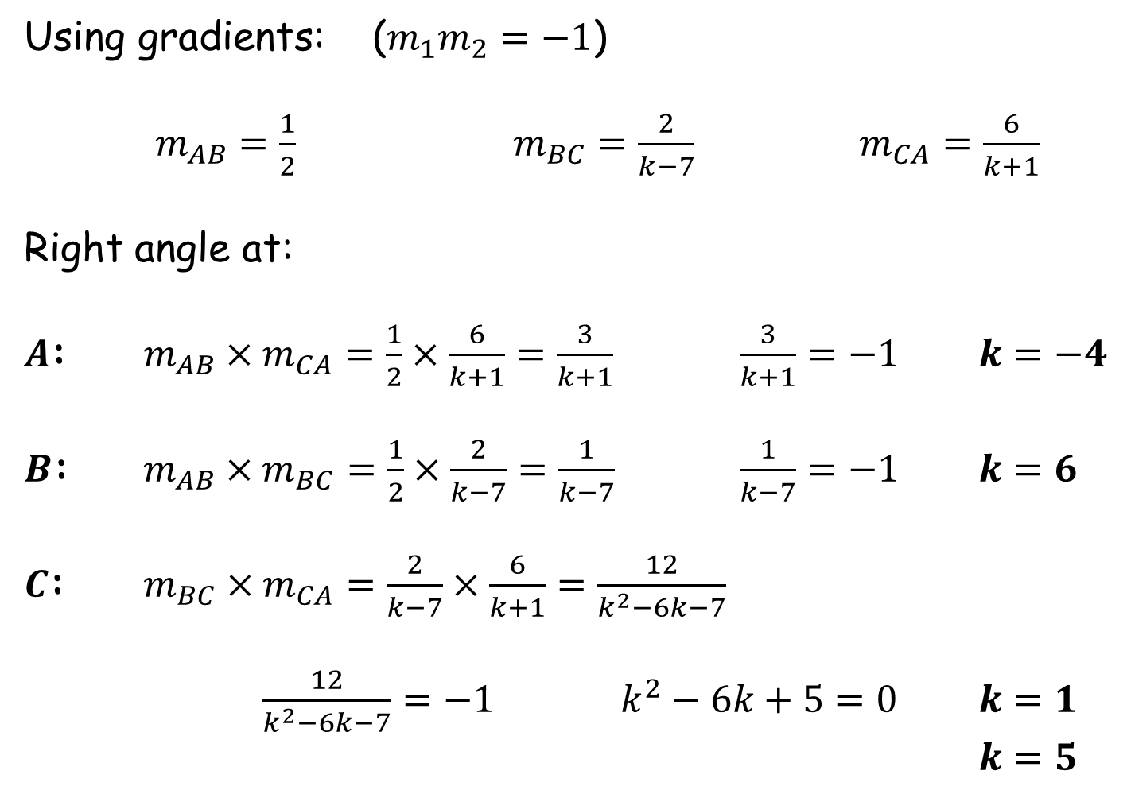
How Many Right-Angled Triangles?
Using gradients: ($m_{1}m_{2}=−1$)
$m_{AB}=\frac{1}{2}$ $m_{BC}=\frac{2}{k−7}$ $m_{CA}=\frac{6}{k+1}$
Right angle at:
$A$: $m_{AB}×m_{CA}=\frac{1}{2}×\frac{6}{k+1}=\frac{3}{k+1}$ $\frac{3}{k+1}=−1$ $k=−4$
$B$: $m_{AB}×m_{BC}=\frac{1}{2}×\frac{2}{k−7}=\frac{1}{k−7}$ $\frac{1}{k−7}=−1$ $k=6$
$C$: $m_{BC}×m_{CA}=\frac{2}{k−7}×\frac{6}{k+1}=\frac{12}{k^{2}−6k−7}$
$\frac{12}{k^{2}−6k−7}=−1$ $k^{2}−6k+5=0$ $k=1$
$k=5$

Slide 12
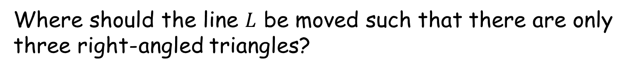

How Many Right-Angled Triangles?
$k=1$ $k=5$
$$L$$
$$B$$
$$A$$
Where should the line $L$ be moved such that there are only three right-angled triangles?

Slide 13


How Many Right-Angled Triangles?
$$L$$
$$C (k,y)$$
$$B$$
$$(7,1)$$
Using gradients: ($m_{1}m_{2}=−1$)
$m_{CA}=\frac{y+3}{k+1}$ $m_{BC}=\frac{y−1}{k−7}$
$\frac{y+3}{k+1}×\frac{y−1}{k−7}=−1$
$$A$$
$$\left(−1,−3\right)$$
Notes:
K=5

Slide 14
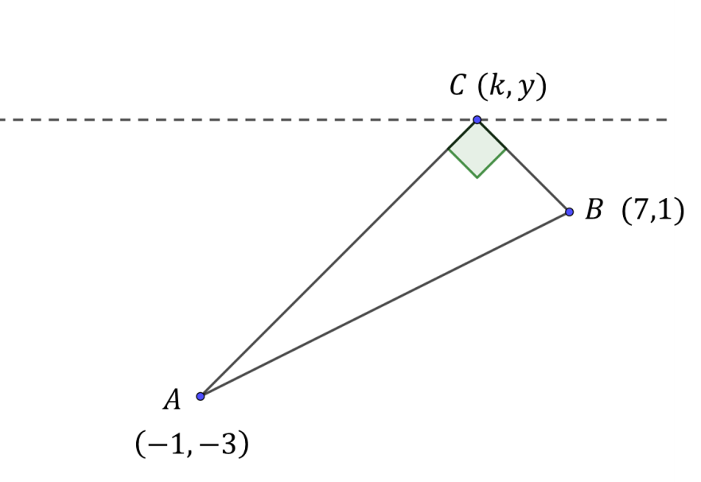
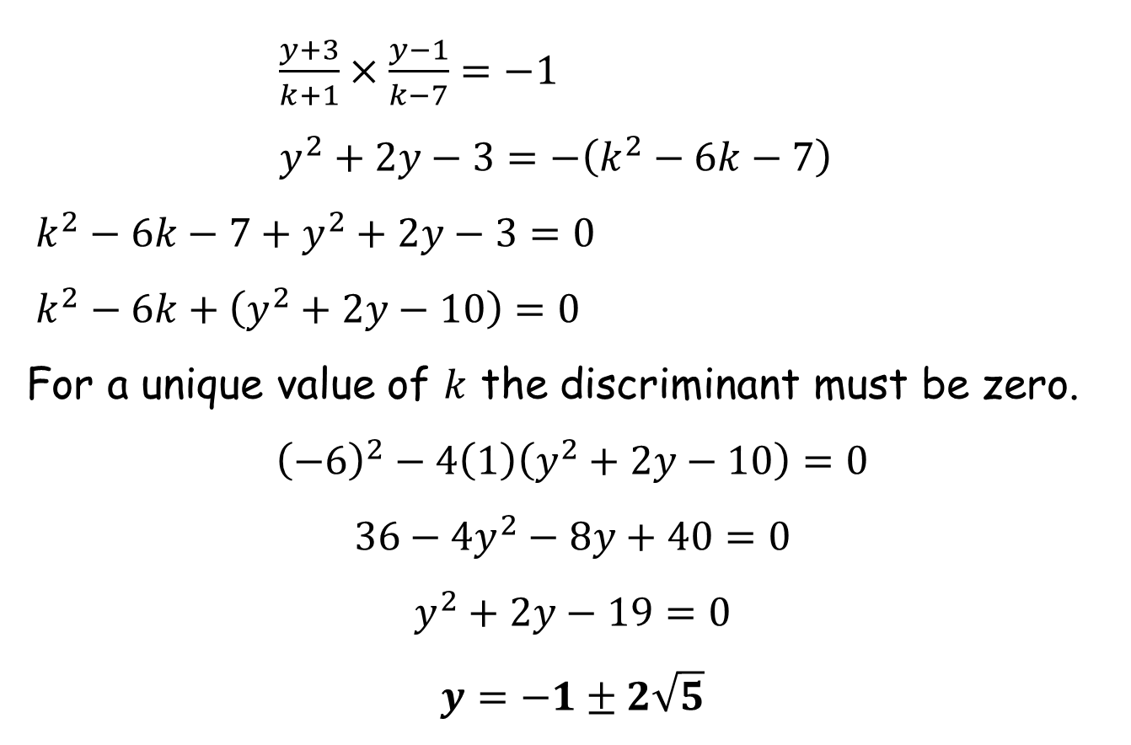
How Many Right-Angled Triangles?
$\frac{y+3}{k+1}×\frac{y−1}{k−7}=−1$
$y^{2}+2y−3=−\left(k^{2}−6k−7\right)$
$k^{2}−6k−7+y^{2}+2y−3=0$
$k^{2}−6k+\left(y^{2}+2y−10\right)=0$
For a unique value of $k$ the discriminant must be zero.
$${\left(−6\right)}^{2}−4\left(1\right)\left(y^{2}+2y−10\right)=0$$
$$36−4y^{2}−8y+40=0$$
$$y^{2}+2y−19=0$$
$$y=−1±2\sqrt{5}$$
Notes:
K=5

Slide 15
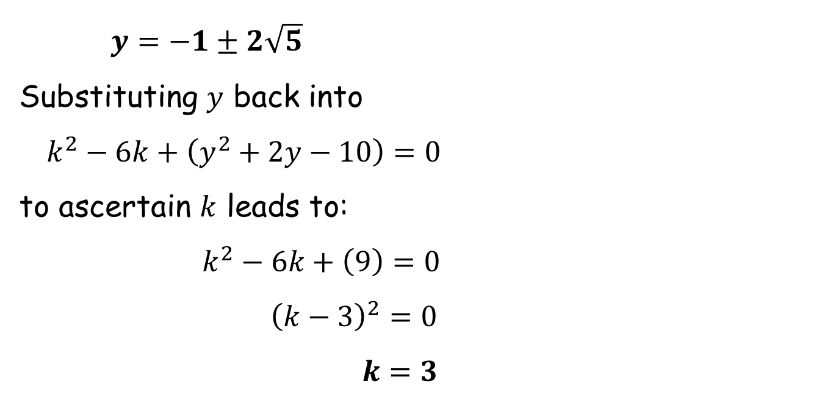
How Many Right-Angled Triangles?
$y=−1±2\sqrt{5}$
Substituting $y$ back into
$k^{2}−6k+\left(y^{2}+2y−10\right)=0$
to ascertain $k$ leads to:
$k^{2}−6k+\left(9\right)=0$
${\left(k−3\right)}^{2}=0$
$k=3$
Notes:
K=5

Slide 16
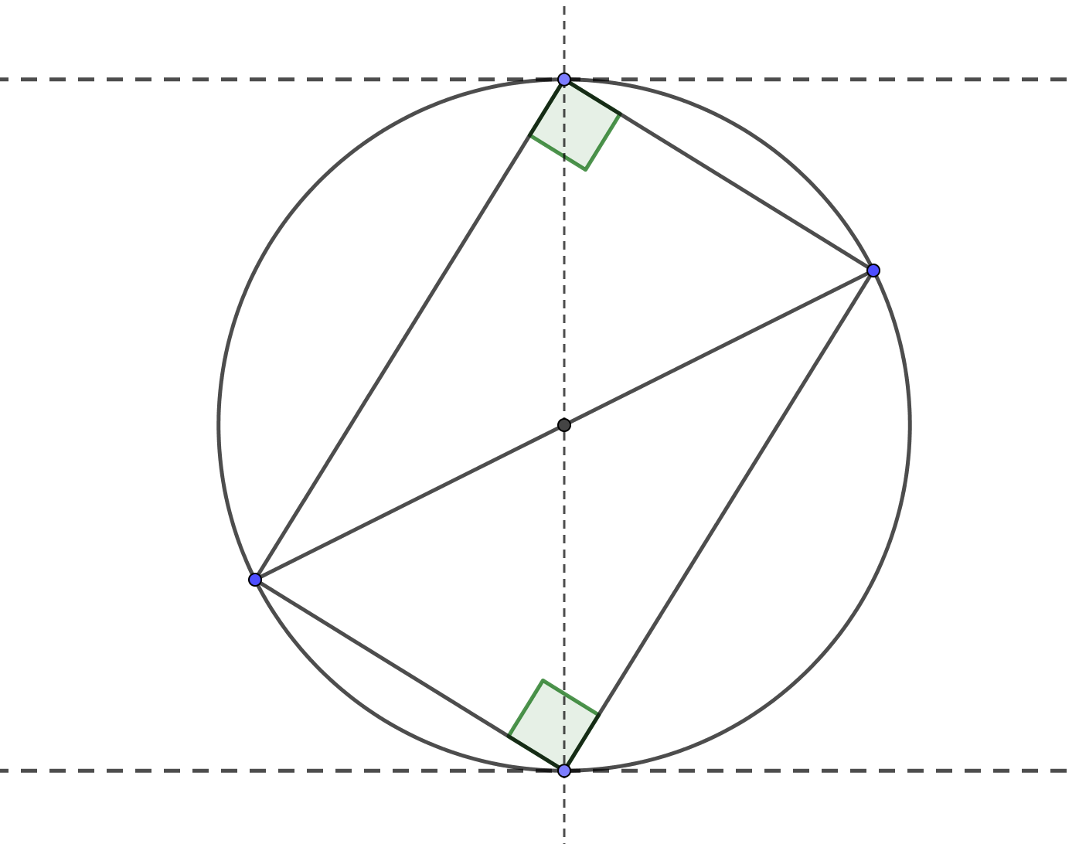


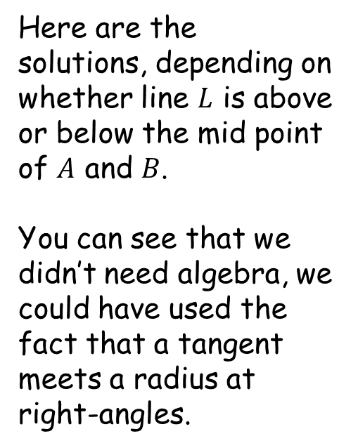





How Many Right-Angled Triangles?
$$L$$
$$C \left(3,−1+2\sqrt{5}\right)$$
Here are the solutions, depending on whether line $L$ is above or below the mid point of $A$ and $B$.
You can see that we didn’t need algebra, we could have used the fact that a tangent meets a radius at right-angles.
$$B$$
$$\left(3,−1\right)$$
$$A$$
$$L$$
$$C \left(3, −1−2\sqrt{5}\right)$$

Slide 18
Note to Teacher
Use the Geogebra file to demonstrate the solutions.
you may need to zoom in to get exact coordinates to get the right angle to show properly, then zoom out again.

Slide 19
RESOURCES

Slide 20
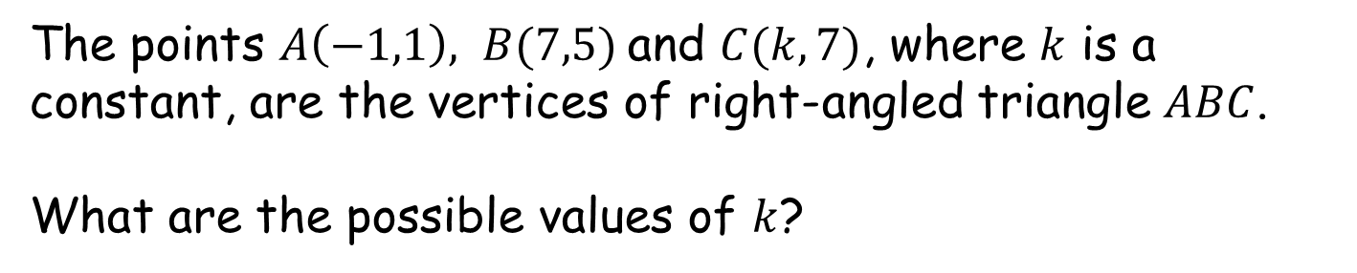
How Many Right-Angled Triangles?
SIC_74
$$C$$
$$B$$
(Not to scale)
A
$$A$$
The points $A\left(−1,1\right), B(7,5)$and $C(k,7)$, where $k$ is a constant, are the vertices of right-angled triangle $ABC$.
What are the possible values of $k$?

Slide 21
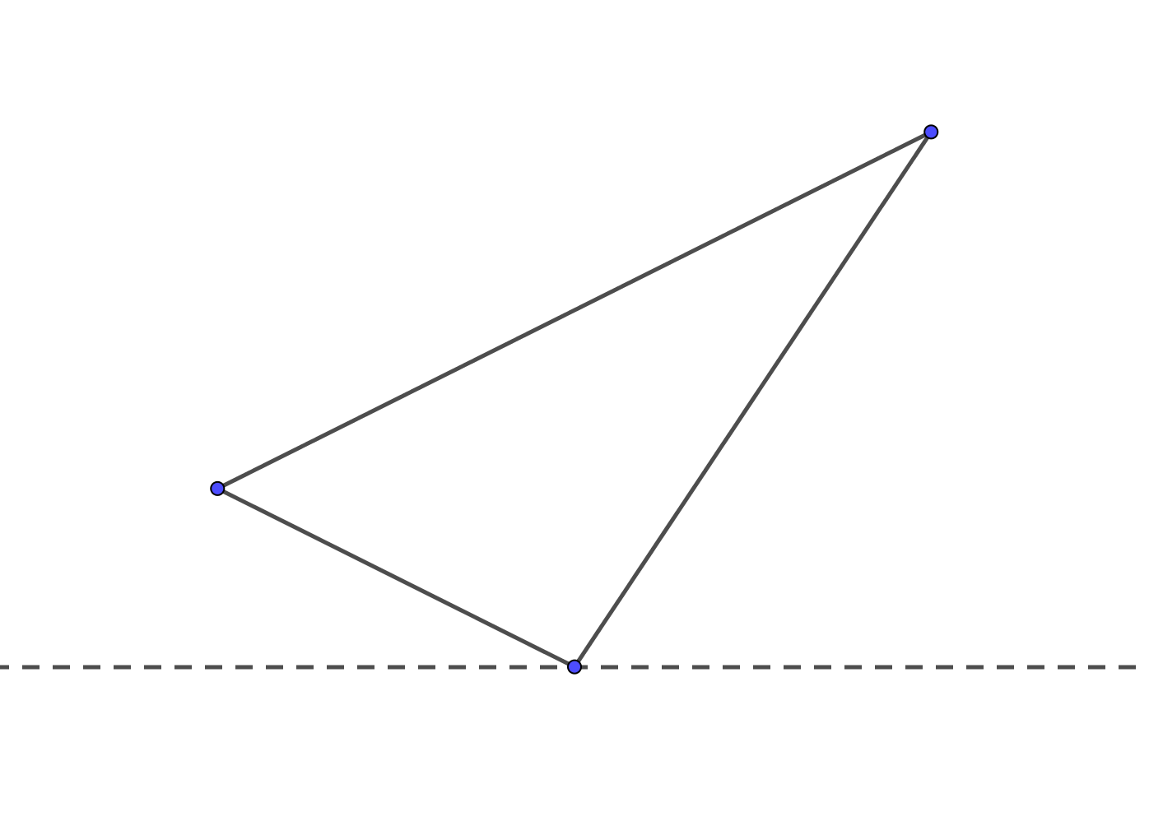

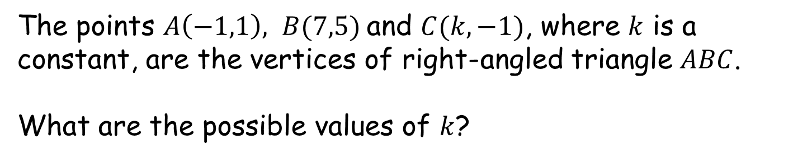

How Many Right-Angled Triangles?
SIC_74
$$B$$
$$A$$
(Not to scale)
B
$$C$$
The points $A\left(−1,1\right), B(7,5)$and $C(k,−1)$, where $k$ is a constant, are the vertices of right-angled triangle $ABC$.
What are the possible values of $k$?

Slide 22
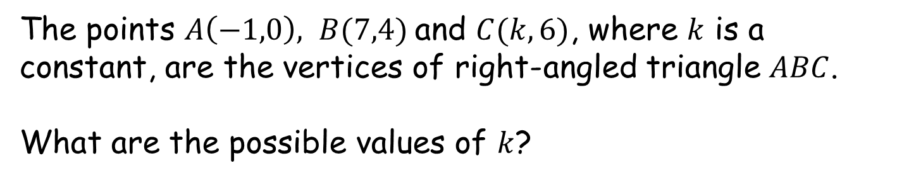
How Many Right-Angled Triangles?
SIC_74
$$C$$
$$B$$
(Not to scale)
C
$$A$$
The points $A\left(−1,0\right), B(7,4)$and $C(k,6)$, where $k$ is a constant, are the vertices of right-angled triangle $ABC$.
What are the possible values of $k$?

Slide 23
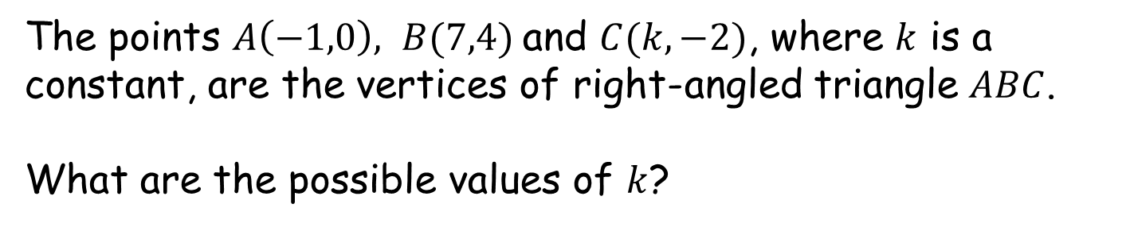
How Many Right-Angled Triangles?
SIC_74
$$B$$
$$A$$
(Not to scale)
D
$$C$$
The points $A\left(−1,0\right), B(7,4)$and $C(k,−2)$, where $k$ is a constant, are the vertices of right-angled triangle $ABC$.
What are the possible values of $k$?

Slide 24
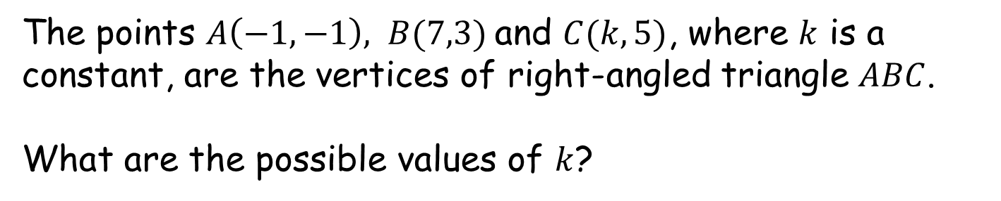
How Many Right-Angled Triangles?
SIC_74
$$C$$
$$B$$
(Not to scale)
E
$$A$$
The points $A\left(−1,−1\right), B(7,3)$and $C(k,5)$, where $k$ is a constant, are the vertices of right-angled triangle $ABC$.
What are the possible values of $k$?

Slide 25
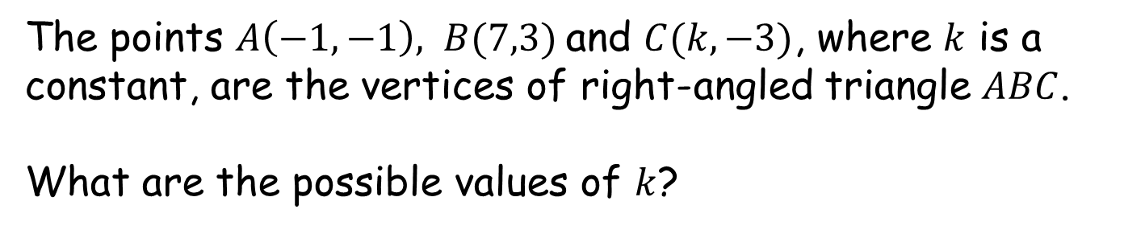
How Many Right-Angled Triangles?
SIC_74
$$B$$
$$A$$
(Not to scale)
F
$$C$$
The points $A\left(−1,−1\right), B(7,3)$and $C(k,−3)$, where $k$ is a constant, are the vertices of right-angled triangle $ABC$.
What are the possible values of $k$?

Slide 26
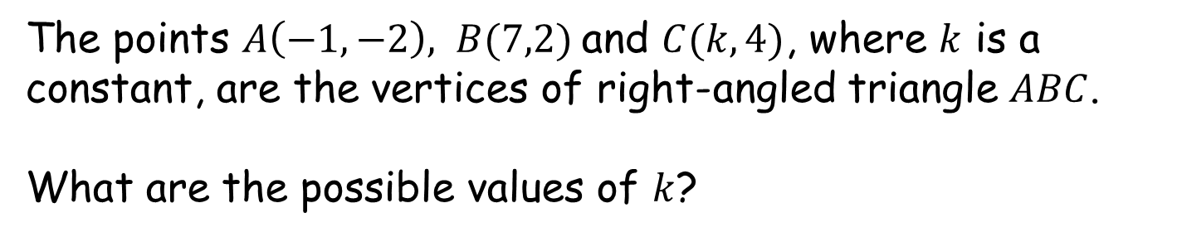
How Many Right-Angled Triangles?
SIC_74
$$C$$
$$B$$
(Not to scale)
G
$$A$$
The points $A\left(−1,−2\right), B(7,2)$and $C(k,4)$, where $k$ is a constant, are the vertices of right-angled triangle $ABC$.
What are the possible values of $k$?

Slide 27
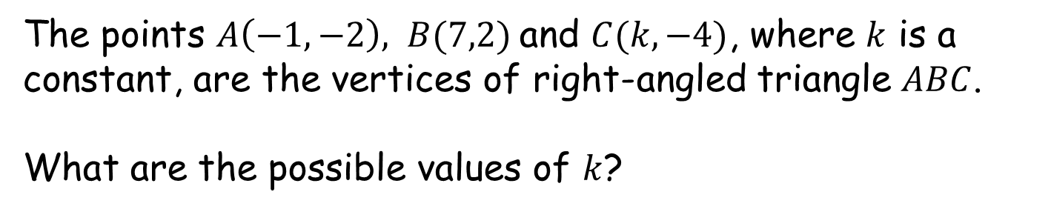
How Many Right-Angled Triangles?
SIC_74
$$B$$
$$A$$
(Not to scale)
H
$$C$$
The points $A\left(−1,−2\right), B(7,2)$and $C(k,−4)$, where $k$ is a constant, are the vertices of right-angled triangle $ABC$.
What are the possible values of $k$?

Slide 28
How Many Right-Angled Triangles?
SIC_74
$$C$$
$$B$$
(Not to scale)
I
$$A$$
The points $A\left(−1,−3\right), B(7,1)$and $C(k,3)$, where $k$ is a constant, are the vertices of right-angled triangle $ABC$.
What are the possible values of $k$?

Slide 29
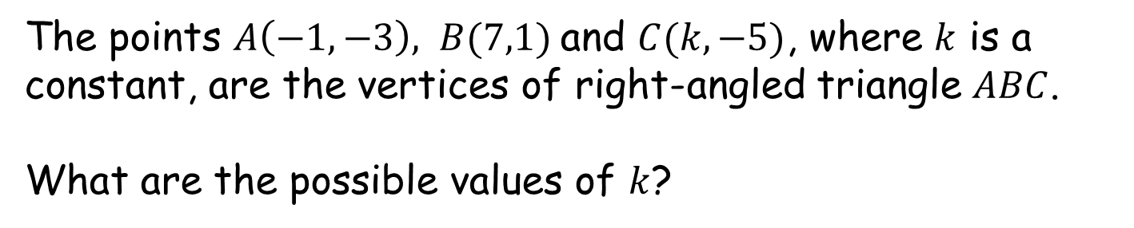
How Many Right-Angled Triangles?
SIC_74
$$B$$
$$A$$
(Not to scale)
J
$$C$$
The points $A\left(−1,−3\right), B(7,1)$and $C(k,−5)$, where $k$ is a constant, are the vertices of right-angled triangle $ABC$.
What are the possible values of $k$?

Slide 30
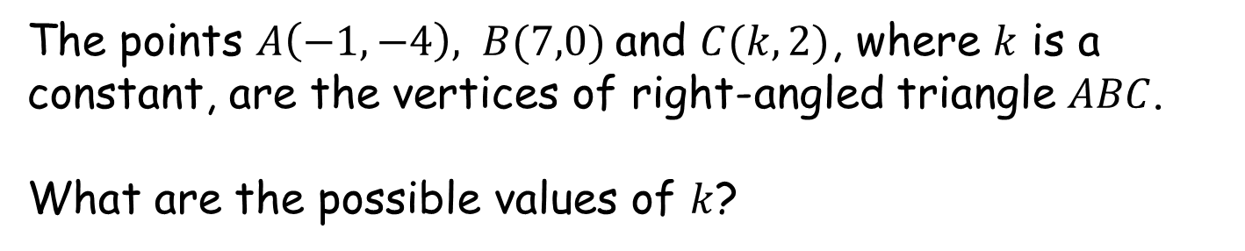
How Many Right-Angled Triangles?
SIC_74
$$C$$
$$B$$
(Not to scale)
K
$$A$$
The points $A\left(−1,−4\right), B(7,0)$and $C(k,2)$, where $k$ is a constant, are the vertices of right-angled triangle $ABC$.
What are the possible values of $k$?

Slide 31
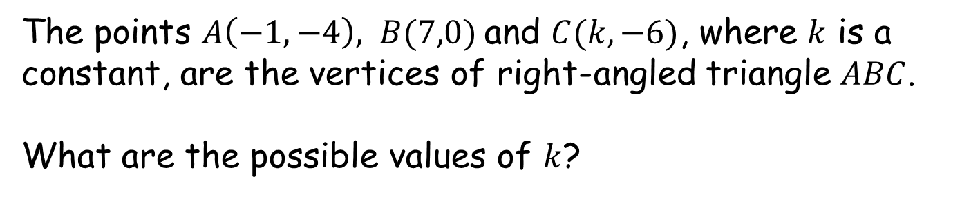
How Many Right-Angled Triangles?
SIC_74
$$B$$
$$A$$
(Not to scale)
L
$$C$$
The points $A\left(−1,−4\right), B(7,0)$and $C(k,−6)$, where $k$ is a constant, are the vertices of right-angled triangle $ABC$.
What are the possible values of $k$?

Slide 32
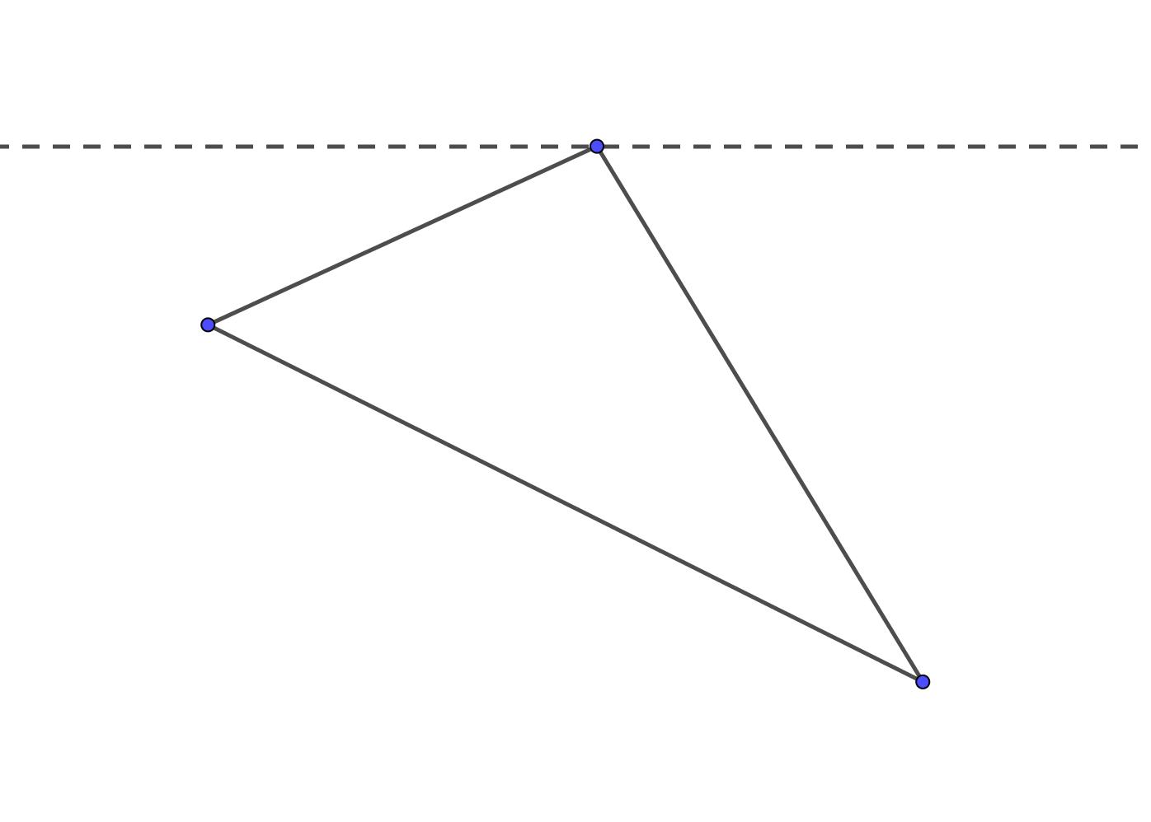

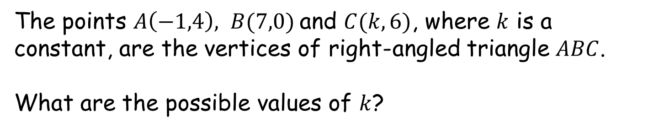

How Many Right-Angled Triangles?
SIC_74
$$C$$
$$A$$
(Not to scale)
M
$$B$$
The points $A\left(−1,4\right), B(7,0)$and $C(k,6)$, where $k$ is a constant, are the vertices of right-angled triangle $ABC$.
What are the possible values of $k$?

Slide 33
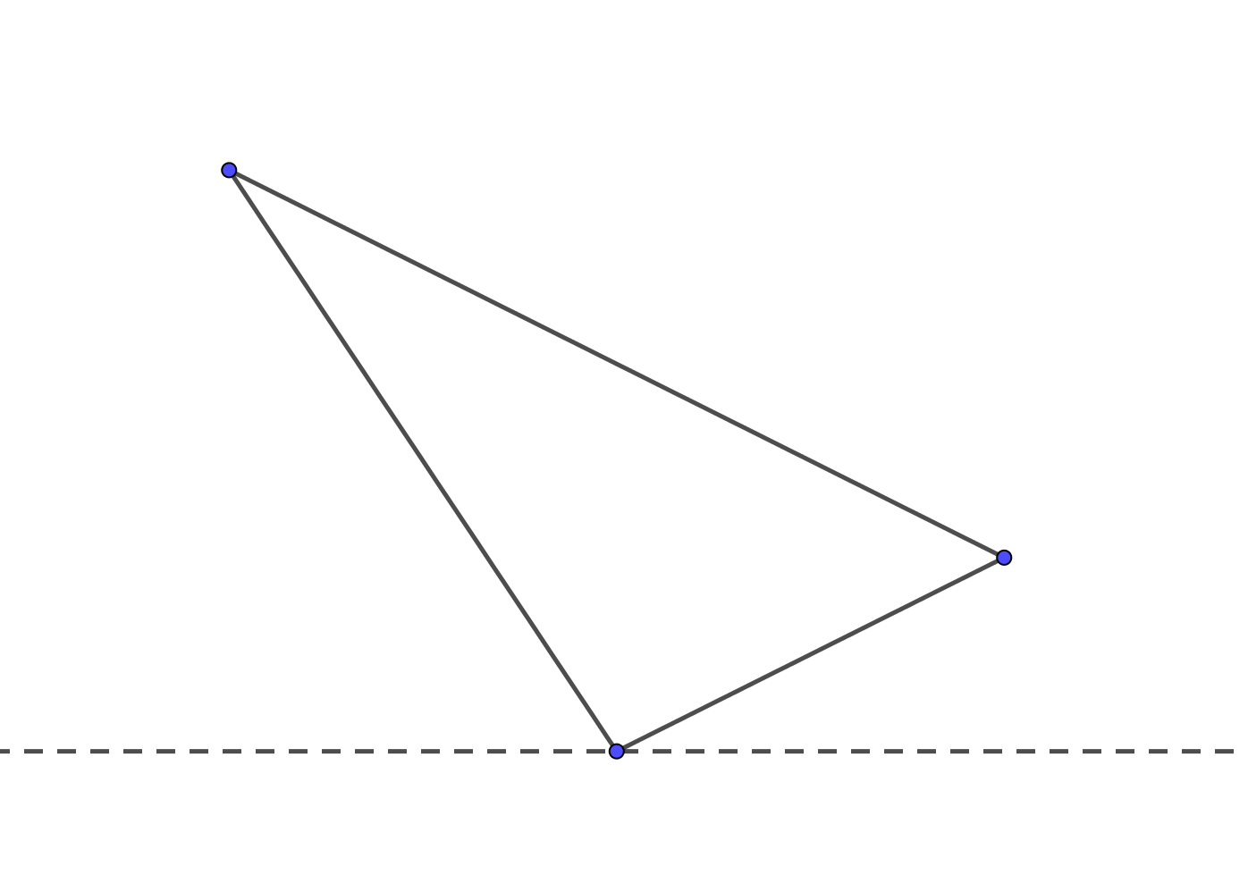

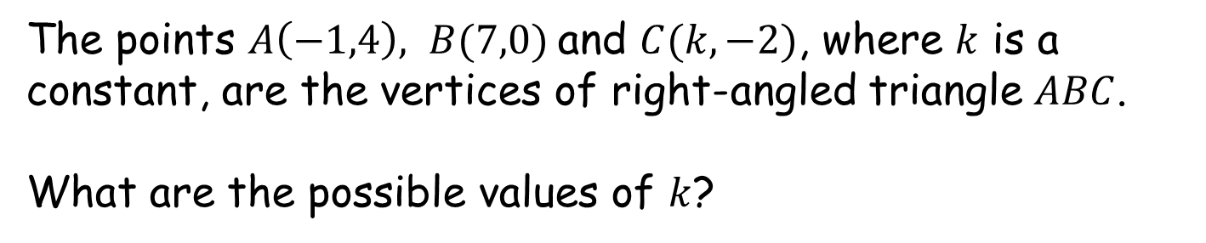


How Many Right-Angled Triangles?
SIC_74
$$A$$
$$B$$
(Not to scale)
N
$$C$$
The points $A\left(−1,4\right), B(7,0)$and $C(k,−2)$, where $k$ is a constant, are the vertices of right-angled triangle $ABC$.
What are the possible values of $k$?

Slide 34

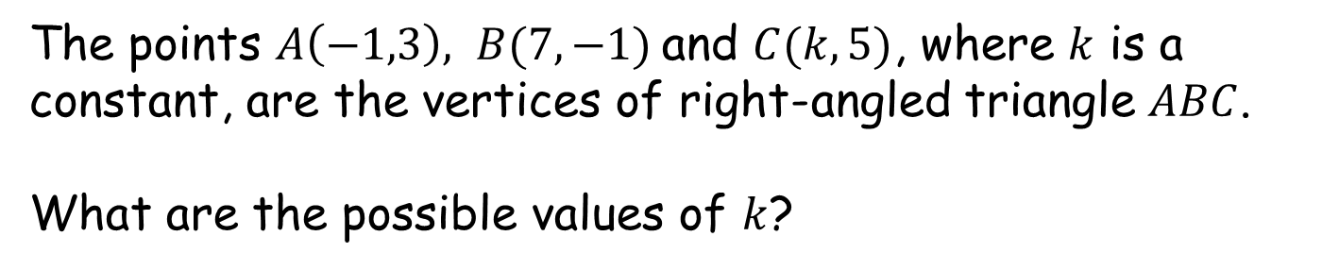

How Many Right-Angled Triangles?
SIC_74
$$C$$
$$A$$
(Not to scale)
O
$$B$$
The points $A\left(−1,3\right), B(7,−1)$and $C(k,5)$, where $k$ is a constant, are the vertices of right-angled triangle $ABC$.
What are the possible values of $k$?

Slide 35

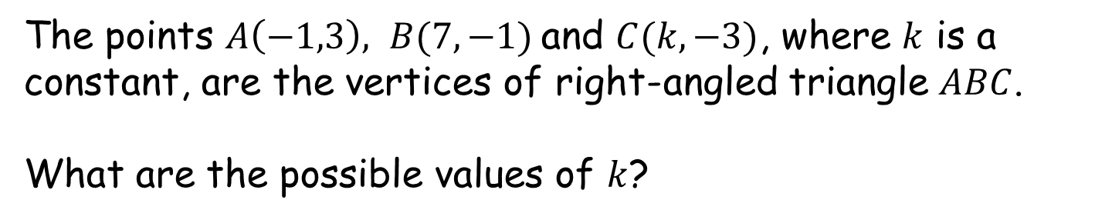


How Many Right-Angled Triangles?
SIC_74
$$A$$
$$B$$
(Not to scale)
P
$$C$$
The points $A\left(−1,3\right), B(7,−1)$and $C(k,−3)$, where $k$ is a constant, are the vertices of right-angled triangle $ABC$.
What are the possible values of $k$?

Slide 36
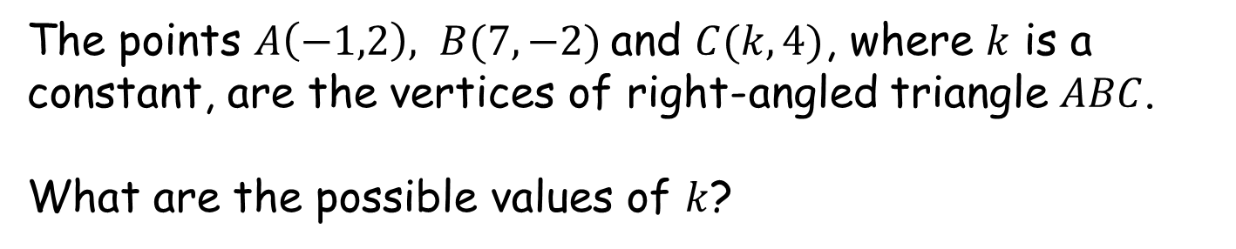
How Many Right-Angled Triangles?
SIC_74
$$C$$
$$A$$
(Not to scale)
Q
$$B$$
The points $A\left(−1,2\right), B(7,−2)$and $C(k,4)$, where $k$ is a constant, are the vertices of right-angled triangle $ABC$.
What are the possible values of $k$?

Slide 37
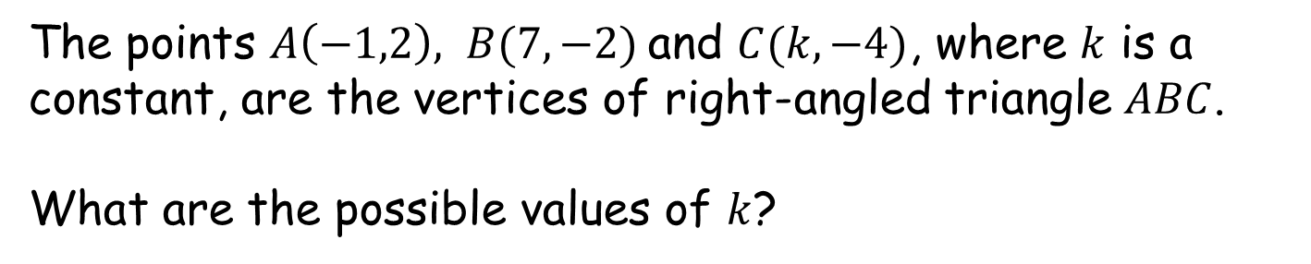
How Many Right-Angled Triangles?
SIC_74
$$A$$
$$B$$
(Not to scale)
R
$$C$$
The points $A\left(−1,2\right), B(7,−2)$and $C(k,−4)$, where $k$ is a constant, are the vertices of right-angled triangle $ABC$.
What are the possible values of $k$?

Slide 38
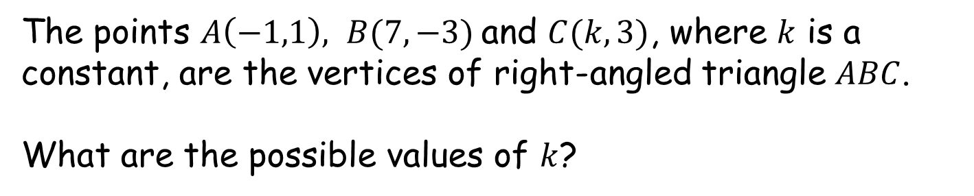
How Many Right-Angled Triangles?
SIC_74
$$C$$
$$A$$
(Not to scale)
S
$$B$$
The points $A\left(−1,1\right), B(7,−3)$and $C(k,3)$, where $k$ is a constant, are the vertices of right-angled triangle $ABC$.
What are the possible values of $k$?

Slide 39
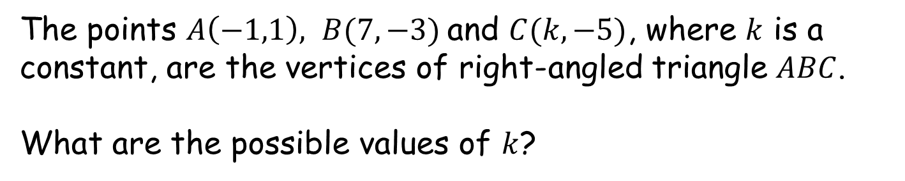
How Many Right-Angled Triangles?
SIC_74
$$A$$
$$B$$
(Not to scale)
T
$$C$$
The points $A\left(−1,1\right), B(7,−3)$and $C(k,−5)$, where $k$ is a constant, are the vertices of right-angled triangle $ABC$.
What are the possible values of $k$?

Slide 40
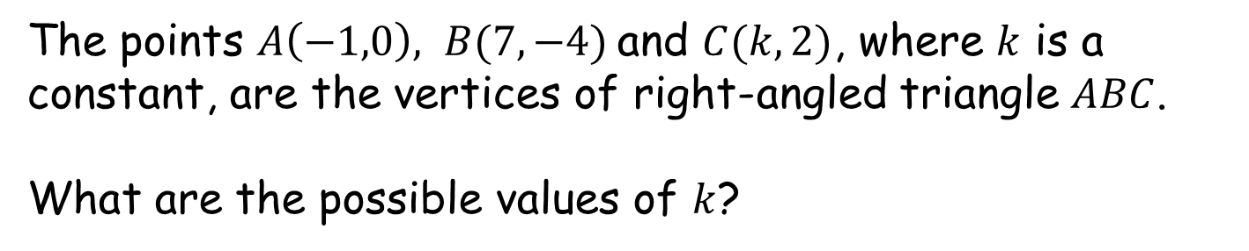
How Many Right-Angled Triangles?
SIC_74
$$C$$
$$A$$
(Not to scale)
U
$$B$$
The points $A\left(−1,0\right), B(7,−4)$and $C(k,2)$, where $k$ is a constant, are the vertices of right-angled triangle $ABC$.
What are the possible values of $k$?

Slide 41
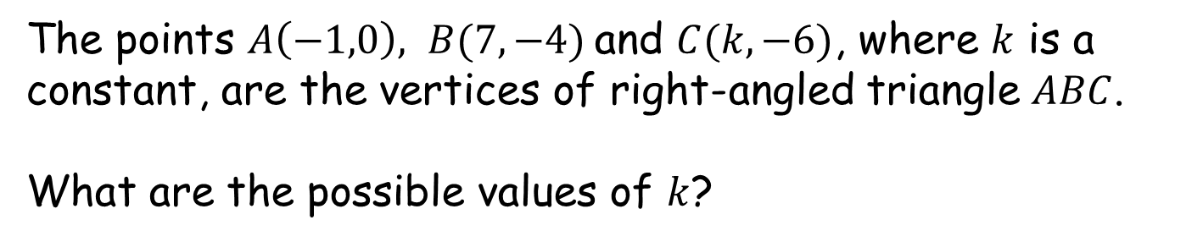
How Many Right-Angled Triangles?
SIC_74
$$A$$
$$B$$
(Not to scale)
V
$$C$$
The points $A\left(−1,0\right), B(7,−4)$and $C(k,−6)$, where $k$ is a constant, are the vertices of right-angled triangle $ABC$.
What are the possible values of $k$?

Slide 42

How Many Right-Angled Triangles?
SIC_74
$$C$$
$$A$$
(Not to scale)
W
$$B$$
The points $A\left(−1,−1\right), B(7,−5)$and $C(k,1)$, where $k$ is a constant, are the vertices of right-angled triangle $ABC$.
What are the possible values of $k$?

Slide 43

How Many Right-Angled Triangles?
SIC_74
$$A$$
$$B$$
(Not to scale)
X
$$C$$
The points $A\left(−1,−1\right), B(7,−5)$and $C(k,−7)$, where $k$ is a constant, are the vertices of right-angled triangle $ABC$.
What are the possible values of $k$?

